Slide 1
VGG

Slide 2
Motivation
Recall AlexNet v.s. LeNet:
AlexNet is deeper and bigger than LeNet to achieve great performance
Go even bigger & deeper?
LeNet
AlexNet

Slide 3
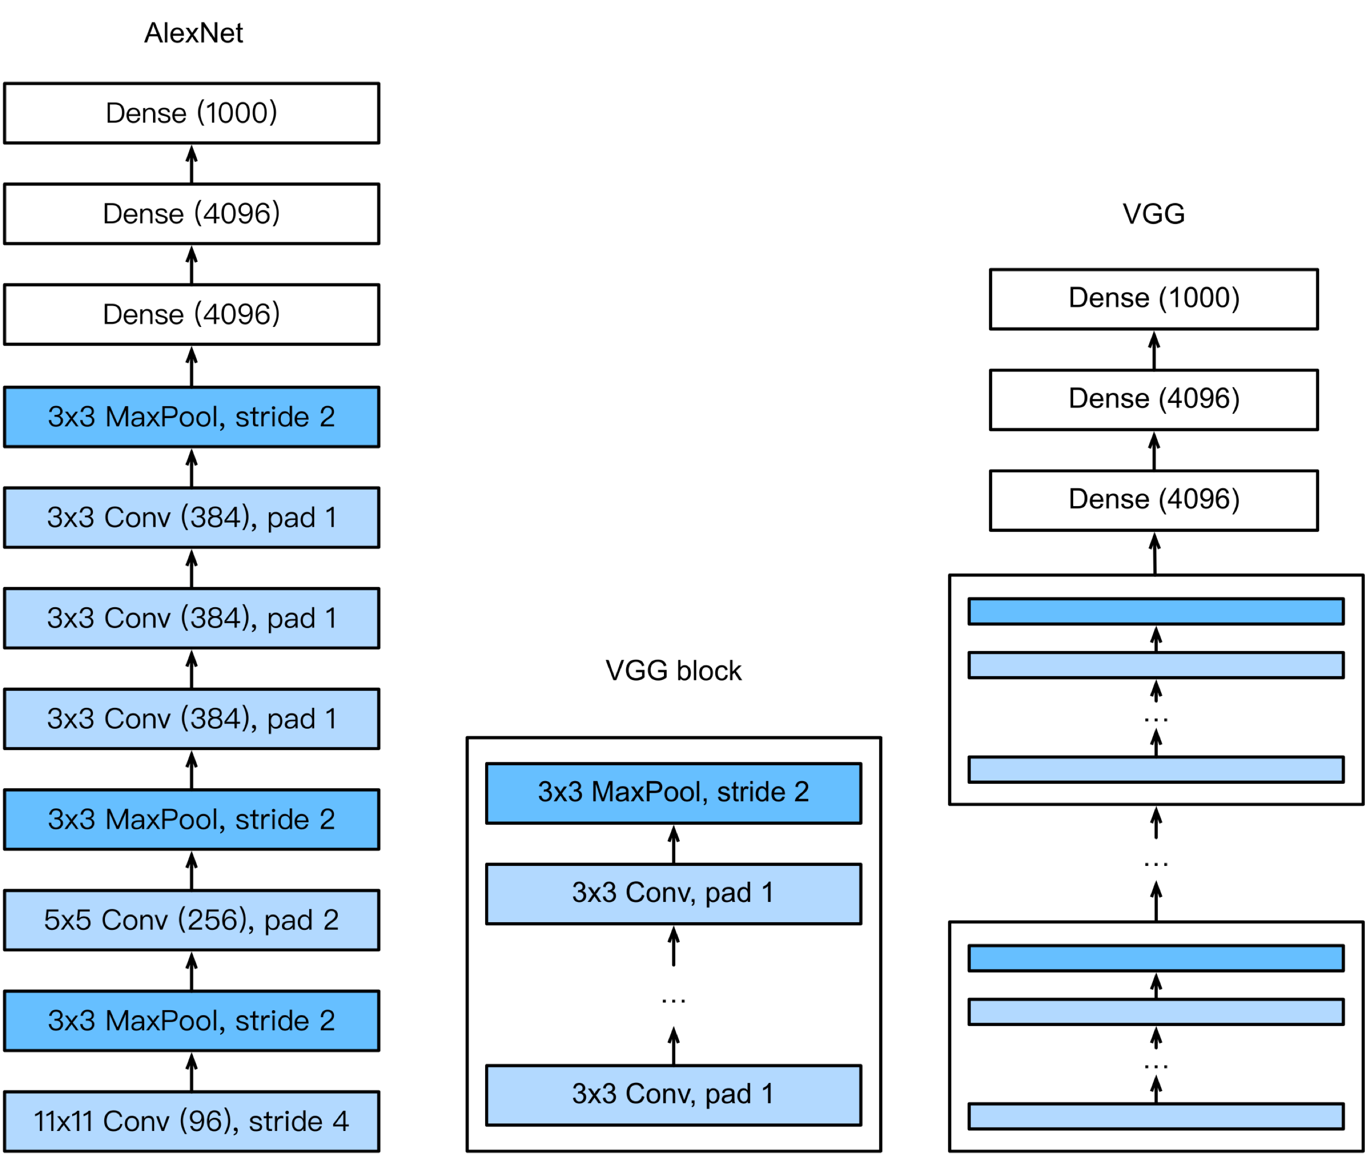
Motivation
AlexNet has 62 M parameters
More Dense layer is too computational expensive!

Slide 4
Motivation
More convolutions
Group into blocks

Slide 5
VGG
Multiple VGG blocks followed by dense layers
Feature size: (height x width) x channels:
(224x224) x 3 -> (7x7) x 512 -> (1x1) x 1000
Simonyan & Zisserman, 2014

Slide 6
VGG Blocks
VGG block
No 5x5 convolutions
More 3x3 convolutions (pad 1) (n layers, m channels)
2x2 max pooling (stride 2)

Slide 7
VGG
Repeating number of blocks to get different architectures, such as:
VGG11 (11 layers) , VGG16 (16 layers) , VGG19 (19 layers), etc.

Slide 8
Issue of Deep Networks
Loss computes at the last layer
Last few layers learn quickly
Data comes in at the first layer
Earlier layers change – everything changes
Last few layers need to relearn
Slow convergence
Data
Loss

Slide 9
Batch Normalization

Slide 10
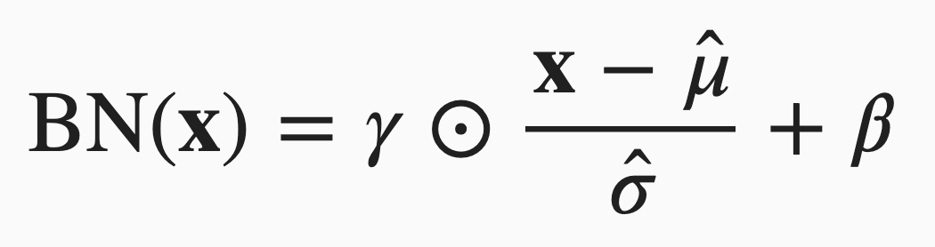
Batch Normalization
At each iteration, within each mini-batch, at each layer, normalize the inputs (from previous layer) with its mean and variance
* Ioffe, S., & Szegedy, C. (2015). Batch normalization.

Slide 11
Batch Normalization
Can be applied to one or many layer(s):
Fully connected layers
Convolution layers
Stabilizing training as regularization
More Details.

